Slide 1

California Housing Price Prediction
Final Project GoldenKeys
Ani Kelenjeridze

Slide 2
THE CHALLENGE
Can We Predict House Prices?
The Question
The Output
Understanding property values is crucial for buyers, sellers, and investors. Can machine learning help us predict California house prices accurately?
A reliable house price prediction that helps stakeholders make informed decisions.
Why This Matters
Key Inputs
Buyers can assess fair pricing
Median household income
Sellers can optimise listings
Geographic location data
Investors can identify opportunities
Property characteristics
Neighbourhood features

Slide 3
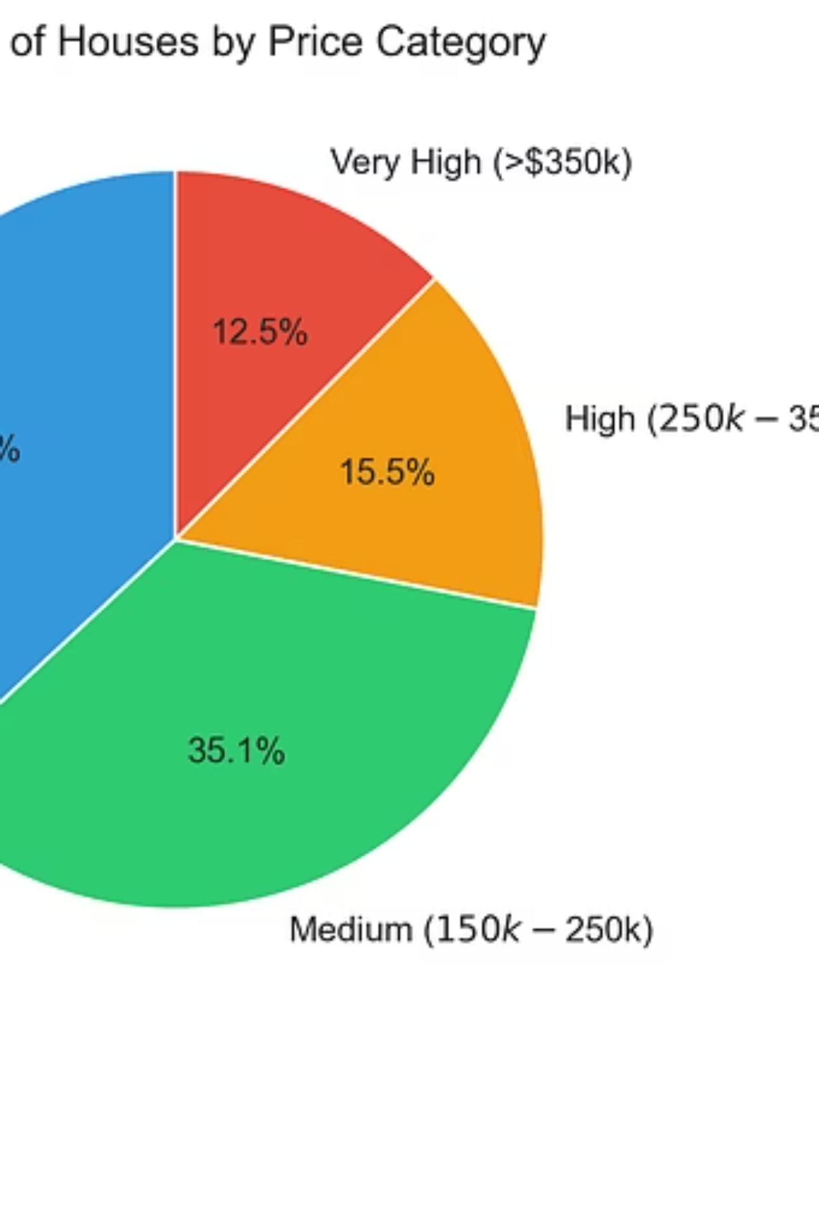
The California Housing Dataset
20,640
8
1990
Properties
Core Features
Census Year
Comprehensive dataset covering diverse California regions
Income, location, age, rooms, and property characteristics
Historical data from US Census Bureau
The dataset provides a rich foundation for understanding housing price dynamics across California's varied markets, from coastal cities to inland communities.

Slide 4

DATA PROCESSING
Preparing the Data for Analysis
01
02
03
Initial Assessment
Data Validation
Outlier Analysis
Examined all 20,640 property records for completeness and quality
Zero missing values discovered—exceptional data quality throughout
Identified high-value properties but retained them as legitimate data points
04
05
Feature Engineering
Final Dataset
Created three new derived features to enhance predictive power
Expanded from 8 to 12 columns, ready for model training

Slide 5

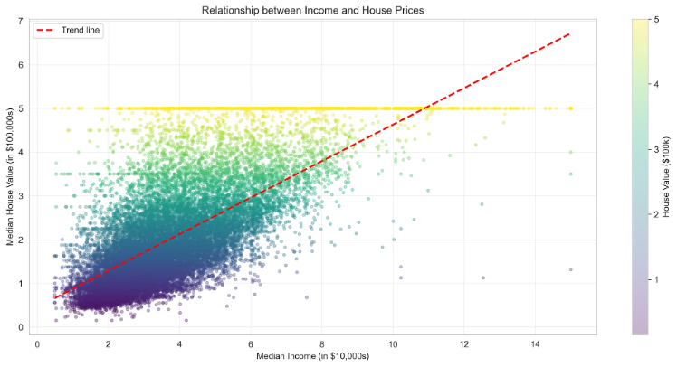
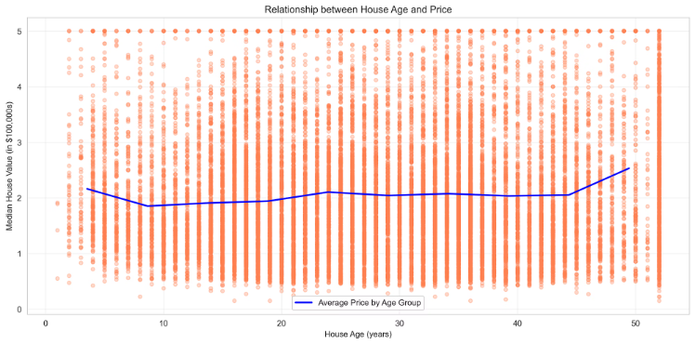
What Drives California House Prices?
Income: The Dominant Factor
Age: Minimal Impact
0.688 correlation
0.106 correlation
Median household income shows by far the strongest relationship with house prices. Areas with higher incomes consistently command premium property values.
Surprisingly, property age has little influence on prices. Location and income far outweigh the building's vintage in determining value.
Location Premium
Coastal properties: £300,000
Inland properties: £150,000
Geographic location creates dramatic price differences, with coastal homes commanding double the value of comparable inland properties.
Analysis of nine comprehensive visualisations revealed these key patterns in California's housing market dynamics.
Prediction errors: Linear Regression RMSE $74,600, Decision Tree RMSE $61,500 – showing Decision Tree's better accuracy.

Slide 6
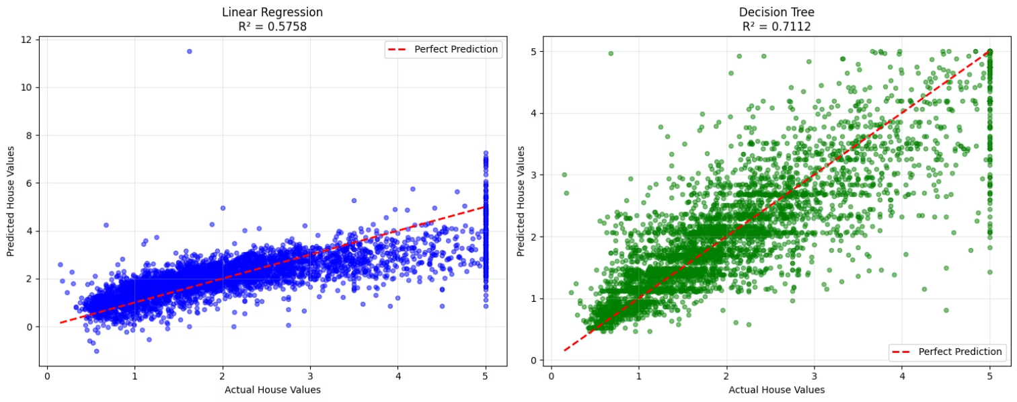

Building the Prediction Models
Linear Regression
1
Fast, interpretable baseline model providing a simple starting point for predictions
Decision Tree
2
More sophisticated algorithm capable of capturing complex, non-linear patterns in the data
Data Split: 80% training set (16,512 properties) and 20% testing set (4,128 properties) to ensure robust model evaluation

Slide 7





Live Model Demonstration
Data Loading
Model Training
Train/test split execution
Both algorithms fitted
Predictions
Evaluation
Real-time results generated
Performance metrics calculated
The interactive demonstration showcases the complete machine learning pipeline, from data preparation through model training to final predictions and performance analysis.

Slide 8
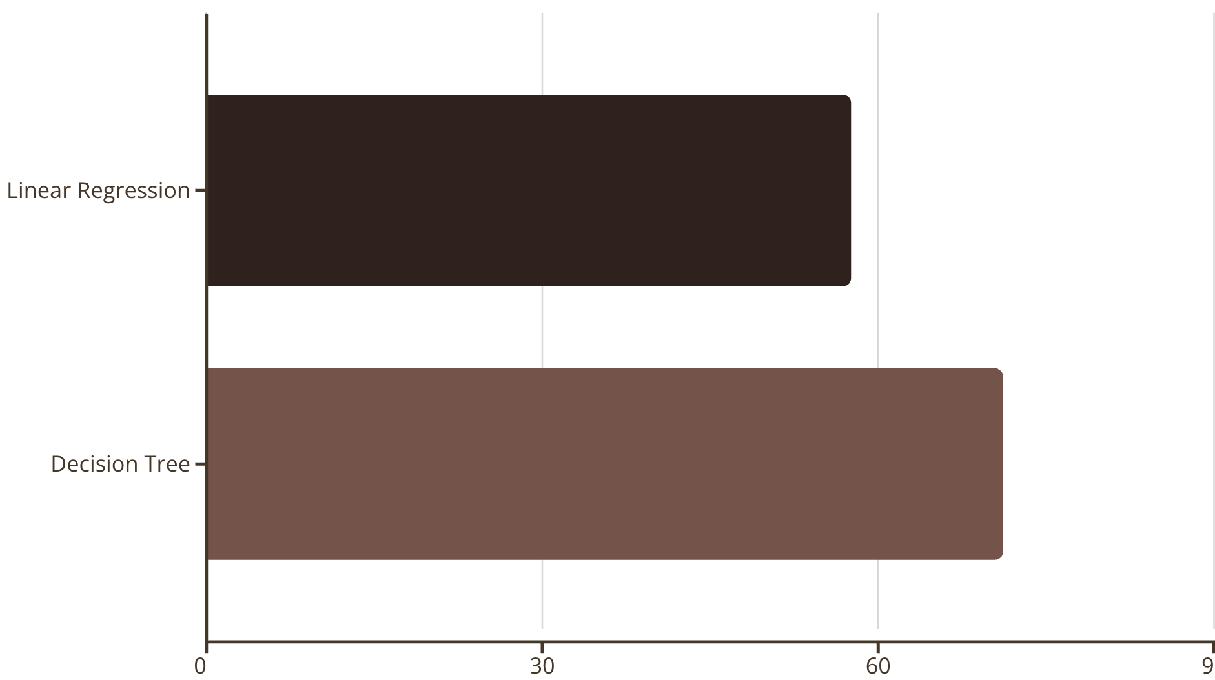


RESULTS
Decision Tree Outperforms Linear Regression
13.5%
62.8%
Accuracy Improvement
Income Importance
Decision Tree's performance advantage
Feature driving model decisions
The Decision Tree model achieved 71.1% accuracy compared to Linear Regression's 57.6%, with £13,000 lower prediction error. Income alone accounts for nearly two-thirds of the model's decision-making process.

Slide 9
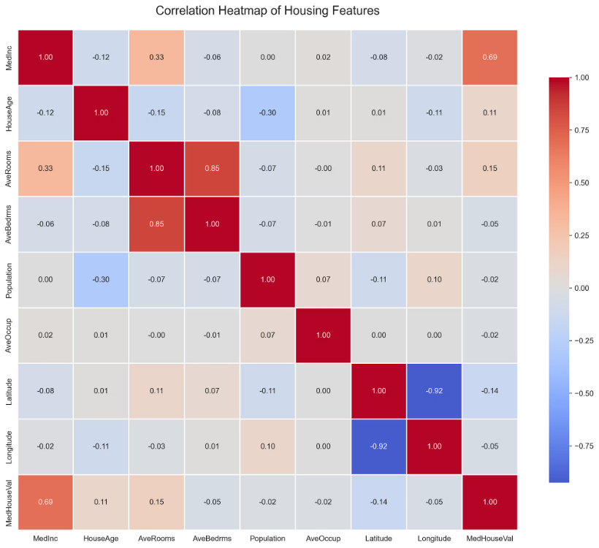

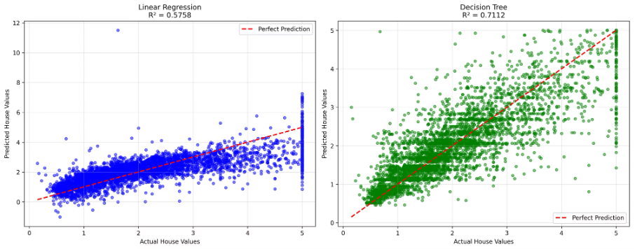
Key Insights from the Analysis
1
Income dominates pricing
With 0.688 correlation, median household income is the single most powerful predictor of property values across California
2
Location creates dramatic premiums
Coastal properties command prices double those of inland areas, demonstrating geography's substantial impact
3
Age matters surprisingly little
Property age shows minimal correlation (0.106) with price—location and income far outweigh vintage
4
Machine learning delivers results
Decision Tree got an R² score of 0.711 and an RMSE of about $61,500
5
Complex models outperform simple ones
Decision Tree's ability to capture non-linear relationships yielded 13.5% better accuracy than Linear Regression

Slide 10


Limitations and Future Directions
Current Limitations
Future Work
Outdated dataset
Current data integration
1990 Census data is 35 years old—market dynamics have evolved significantly
1
Incorporate 2026 property listings
Missing critical features
Feature expansion
Property condition, school quality, and crime rates could enhance predictions
2
Add condition, amenities, schools
Unexplained variance
3
Advanced algorithms
29% of price variation remains unaccounted for by current model
Test Random Forest and XGBoost
4
Web application
Deploy interactive prediction tool
Project Summary
Successfully processed 20,640 properties • Created 9 visualisations • Trained 2 models • Achieved 71% accuracy
Main finding: Income is the number one predictor of California house prices

